Slide 1



VIGNESH M

Slide 2
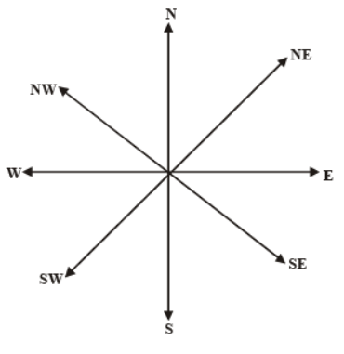
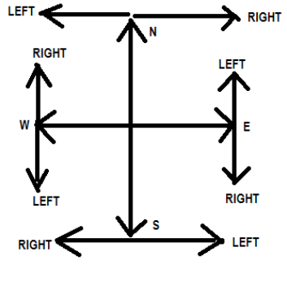

Slide 3
1. Prabir started walking towards South. He took a right turn after walking 10 metres. He again took a left turn after walking 20 meters. Which direction is he facing now ?
(1) South (2) North (3) West (4) East (5) Cannot be determined

Slide 4
2. Kunal walked 10m. towards the East, turned right and walked another 15m. He then turns left and walks 3 m. He finally takes a left turn and walks 6m. Which direction is he facing now?
(1) East (2) North (3) West (4) South (5) South West

Slide 5
3. W walked 30 metres towards South, took a left turn and walked 50 metres, again he took a left turn and walked 30 metres. How far is he from the starting point?
(1) 80 meters (2) 100 metres (3) 130 metres (4) 50 metres (5) None of these

Slide 6
4. W walked 40 metres towards West, took a left turn and walked 30 metres. He then took a right turn and walked 20 metres. He again took a right turn and walked 30 metres. How far was be from the starting point ?
(l) 70 metres (2) 60 metres (3) 90 metres (4) Cannot be determined (5) None of these

Slide 7
5. Sushil walked 15 metres towards South, took a left turn and walked 20 metres again he took, a left turn and walked 15 metres. How far and in which direction is be from the starting point ?
(1) 20 metres, West (2) 20 metres, East (3) 50 metres, West (4) 50 metres, East (5) Data inadequate

Slide 8
Directions (6-7) : Study the following information carefully and answer the given questions :
Point B is 12 metres south of point A. Point C is 24 metres east of point B. Point D is 8 metres south of point C. Point D is 12 metres east of point E and point F is 8 metres north of point E.
6.If a man has to travel to point E from Point A (through these points ), which of the following points will he pass through first ?
(1) Point C (2) Point D (3) Point F (4) Point B (5) None
7. If a man is standing facing north at point C, how far and in which direction is point F From that man ?
(1) 12 metres west (2) 24 metres east (3) 12 metres east (4) 24 metres west (5) None of thess

Slide 9
Directions (8-10) : Study the following information carefully and answer the questions given below :
Point B is 25 m south of Point A. Point C is 10 m east of Point B. Point D is 30 m north of Point C. Point E is 7 m east of Point D. Point X is 18 m south of Point E. Point M is 12 m south of Point X. Point C is 7 m west of Point M.
8. Point B is in which direction from Point D?
(1) South (2) South-West (3) North-East (4) South-East (5) North
9. If Point W is 3 m to the north of Point A. then what is the distance between Points B and W?
(1) 28 m (2) 15 m (3) 21 m (4) 24 m (5) 17 m
10. What is distance between Points B and M?
(l) 19 m (2) 15 m (3) 21 m (4) 17 m (5) 13 m

Slide 10
Directions (11-13) : Study the following information carefully and answer the questions given below
R is 15m west of Q . J is 6m north of Q. W is 2m west of J. L is 10m south of W. K is 6m west of L.
11. If F is 4m to the south of R and V is 2m east of K. how far is Point F from Point V?
(1) 8m (2) 11m (3) 5m (4) 9m (5) 4m
12. Kabir walks 10m towards south from Point J , takes a right turn and walks for 3m. How far will he be from Point K?
(1) 4 m (2) 10 m (3) 5 m (4) 6 m (5) 9 m
13. In which direction is R with respect to J ?
(1) West (2) South east (3) North east (4) North 5) South west

Slide 11
14.one evening. Raja started to Walk towards the Sun. After walking a while, he turned to his right and again to his right. After walking a while, he again turned right. In which direction is he facing ?
(1) South (2) East (3) West (4) North

Slide 12
15.A boy started walking positioning his back towards the sun. After sometimes, he turned left, then turned right and then towards the left again. In Which direction is he going now?
(1) East or West (2) North or West (3) South or West (4) North or South

Slide 13
16. P is 60 m South-East of Q. R is 60 m North-East of Q. Then R is in which direction of P ?
(1) North (2) North-East (3) South (4) South-East

Slide 14
17.Rahul put his timepiece on the table in such a way that at 6 P.M. hour hand points to North. In which direction the minute hand will point at 10.15 P.M. ?
A) South B) North C) West D) Southwest

Slide 15
18.If South-East becomes North and North-East becomes West .. What will south become?
A) South B) North east C)North West D) Southwest

Slide 16
19. A man is facing north. He turns 90° in the anticlockwise direction and then 135° in the clockwise direction. Which direction is he facing now?
(1) North-east (2) North-west (3) Southeast (4) Southwest

Slide 17
20.Morris is facing North and walks 10kms. He turns 270° anti-clockwise and walks 15kms. Now, he again turns 45° clockwise and walks for 25kms. Which direction is he facing now?
A) North-West B) South-West C) North-East D) South-East

Slide 18
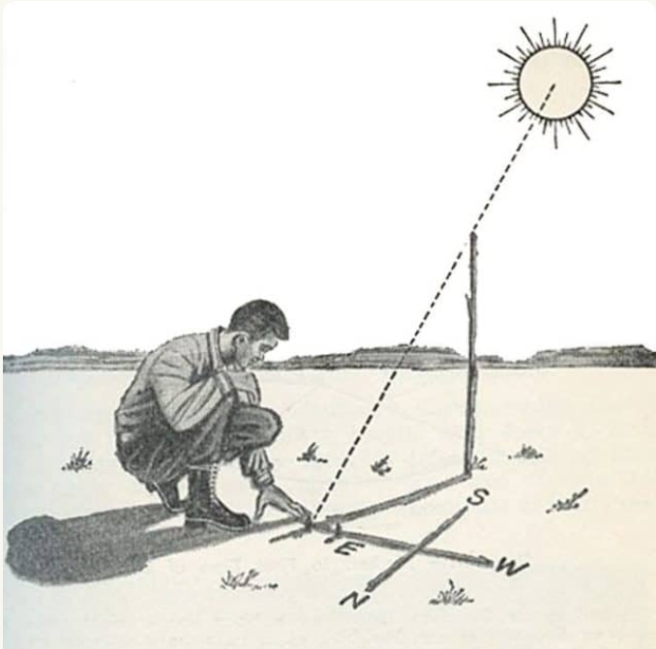
21. One fine morning after sun-rise, Vikram and Sailesh were standing in a lawn with their backs towards each other. Vikram's shadow fell exactly towards his left hand side. Which direction was ' Sailesh facing?
(A) East (8) West (C) North (4) South

Slide 19
THANK YOU

